Slide 1

May 27, 2022
PROJECT REPORT
FACE DETECTION AND TRACKING USING NEURAL NETWORK AND KLT ALGORITHM
Supervisor: Tran Nhat Quang

Slide 2
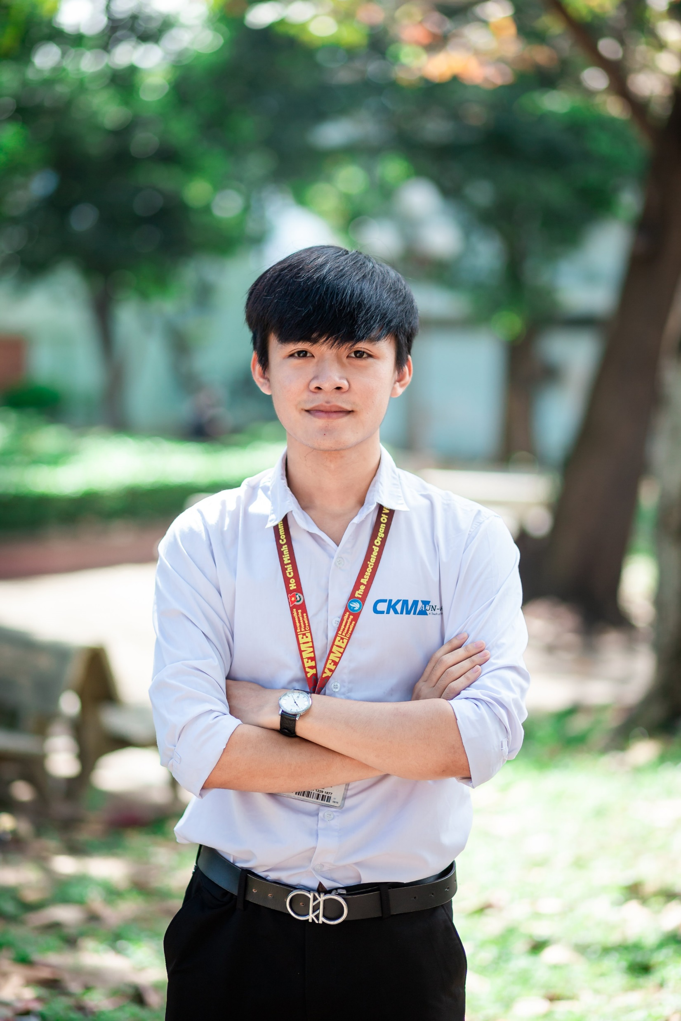
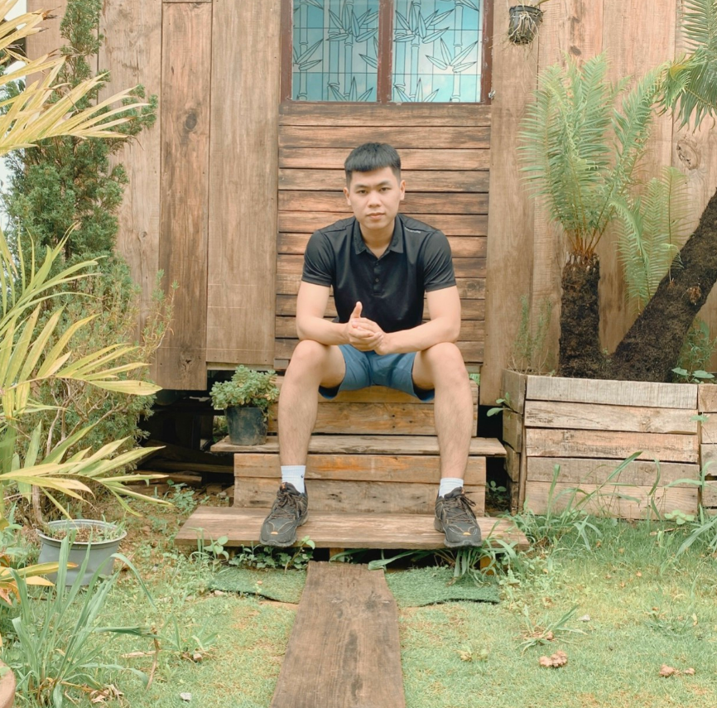
May 27, 2022
QUAN
TEAM MEMBER
Le Quoc Tuan – 19134091
Dao Thanh Quan -19134081
will represent this report
TUAN
Supervisor: Tran Nhat Quang

Slide 3
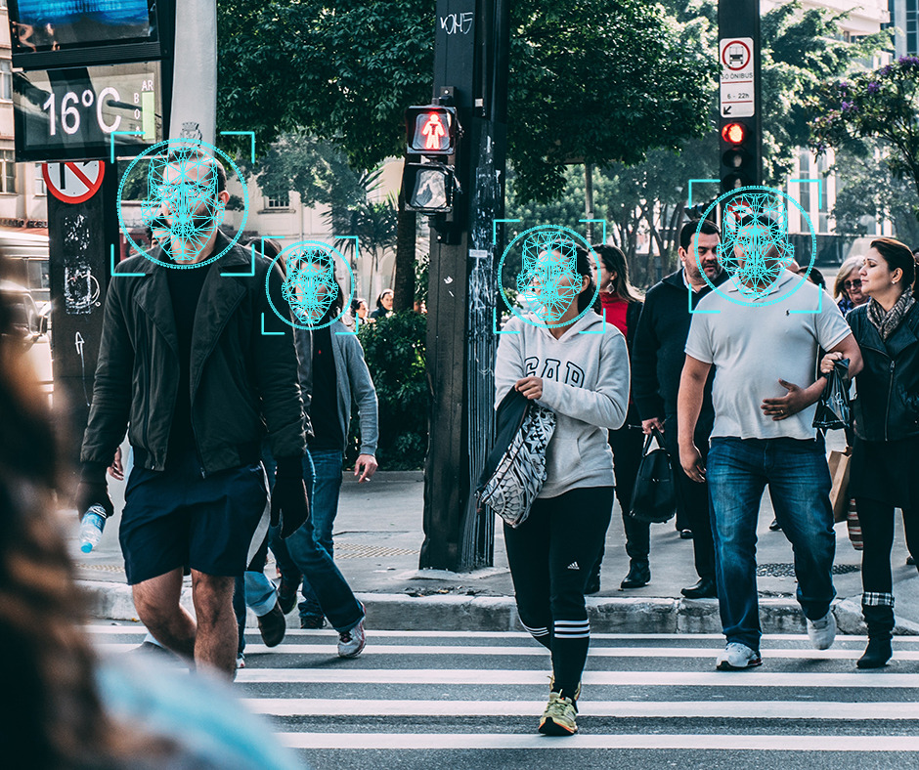
Introduction
Face detection in real life
01
Popular
02
Diverse application
Supervisor: Tran Nhat Quang
Image Source: Google

Slide 4
May 27, 2022
Face Detection
Supervisor: Tran Nhat Quang

Slide 5
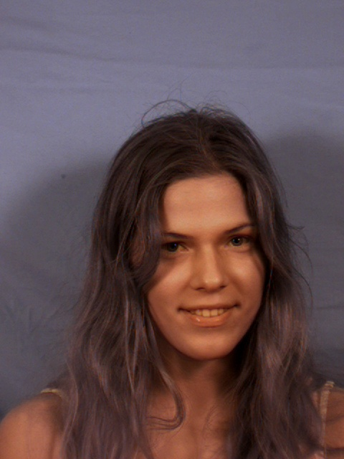
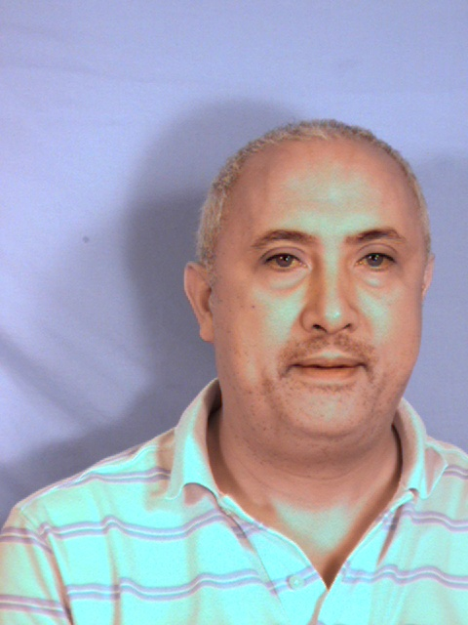
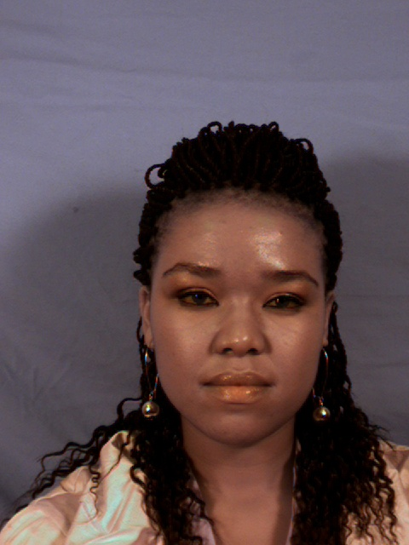
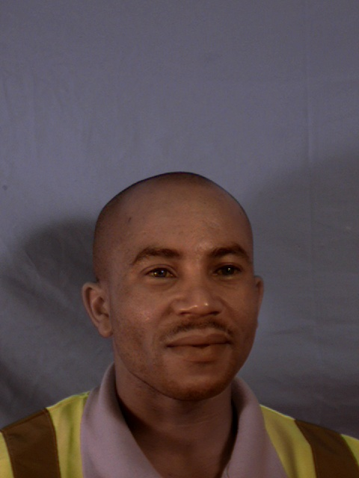
Datasets
Author: S. Milborrow and J. Morkel and F. Nicolls
Title: The MUCT Landmarked Face Database
Journal:{Pattern Recognition Association of South Africa}
Year:2010
Note: http://www.milbo.org/muct
Consists of 3755 faces with 76 manual landmarks
Supervisor: Tran Nhat Quang

Slide 6
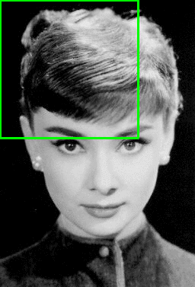
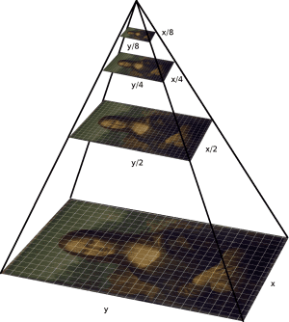
Image Pyramid and Sliding Window
01
Image Pyramid is a type of multi-scale representation
Sliding Window is a rectangular that “slides” across an image
02
Objectives: Scale image multiple time and let window slide across the image to find best fitted face
03
Image Source: https://huytranvan2010.github.io/Image-pyramid-with-Python/
https://pyimagesearch.com/2015/03/23/sliding-windows-for-object-detection- with-python-and-opencv/
Supervisor: Tran Nhat Quang

Slide 7
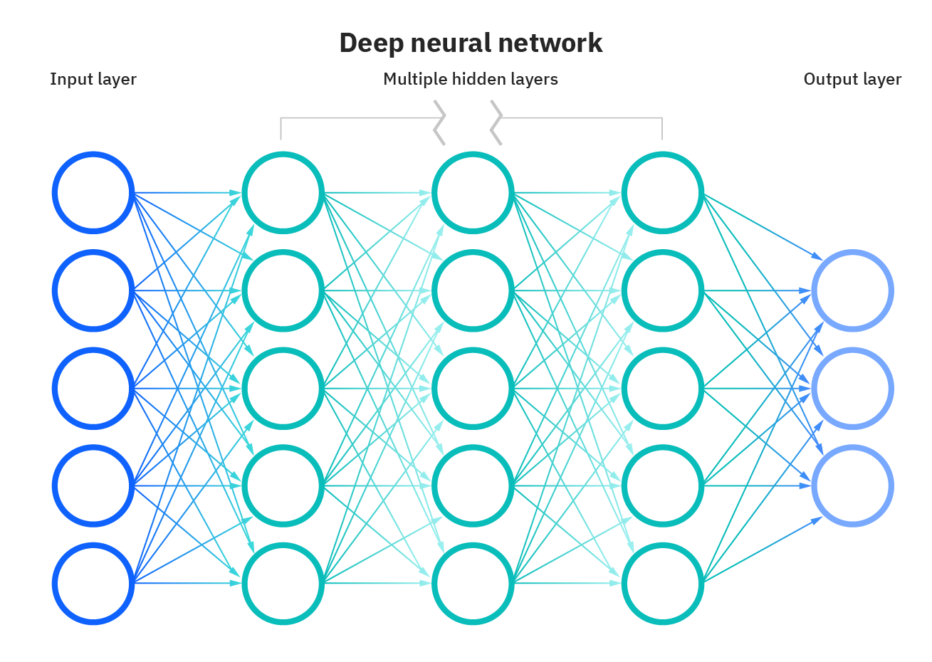
Neural Network
01
Also known as ANNS
02
A subset of Machine Learning
03
Inspired by the human brain, mimicking the way that biological neurons signal to one another
Supervisor: Tran Nhat Quang
What are neural networks? Retrieved from https://www.ibm.com/cloud/learn/neural-networks

Slide 8
Neural Network Architecture
Supervisor: Tran Nhat Quang
Kaipeng Zhang, Zhanpeng Zhang, Zhifeng Li, Yu Qiao - Joint Face Detection and Alignment using Multi-task Cascaded Convolutional Networks.

Slide 9
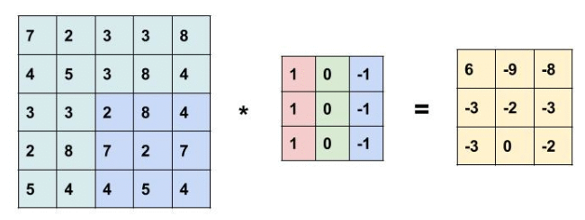
Convolutional Layer
01
Convolution is a mathematical operation
02
The main building block of CNN
03
Contain a set of filter (kernels)
04
Parameters can be learn
04
Result size = (W – F + 2P) / S + 1
Supervisor: Tran Nhat Quang
Image Source:
https://learnopencv.com/image-classification-using-convolutional-neural-networks-in-keras/

Slide 10
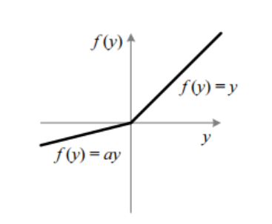
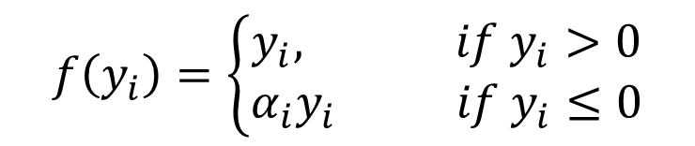
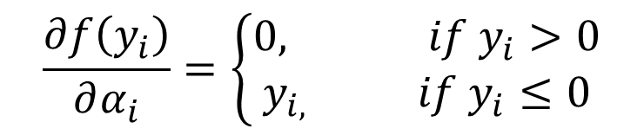
Parametric Rectified Linear Unit
An activation function with mathematical equation:
$$f\left(y_{i}\right)=\left\{\begin{aligned}y_{i}, if y_{i}>0 \\ α_{i}y_{i} if y_{i}≤0\end{aligned}\right.$$
$α_{i}$ is a learnable parameter
For backpropagation, its gradient is
$$\frac{∂f\left(y_{i}\right)}{∂α_{i}}=\left\{\begin{aligned}0, if y_{i}>0 \\ y_{i,} if y_{i}≤0\end{aligned}\right.$$
Supervisor: Tran Nhat Quang

Slide 11
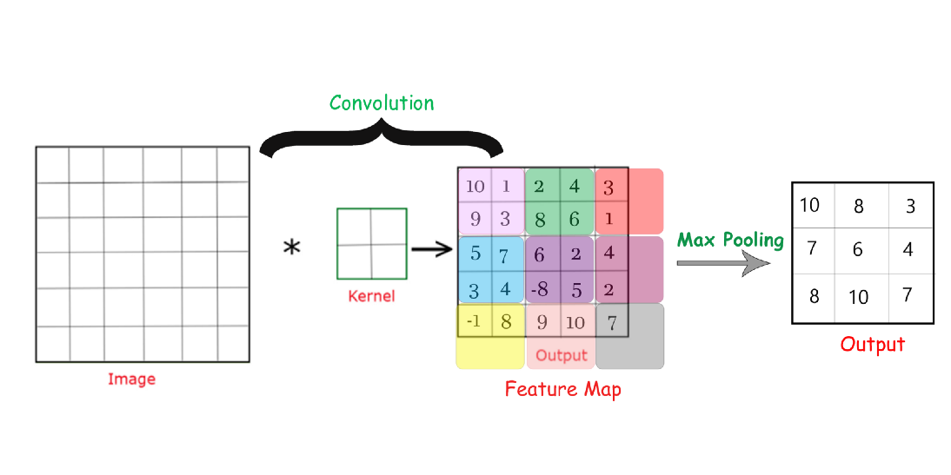
Max Pooling
01
Usually used after a convolutional layer
03
Used to downscale the image
Calculate the maximum value of feature map
Extracting the most important
feature in a region
02
04
Supervisor: Tran Nhat Quang
Max Pooling, Why use it and its advantages . Retrieve from
https://medium.com/geekculture/max-pooling-why-use-it-and-its-advantages-5807a0190459

Slide 12
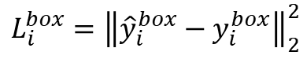
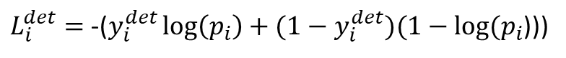
Loss Function
01
Cross-entropy loss for face classification:
$L_{i}^{det}=$ -($y_{i}^{det}\log\left(p_{i}\right)+(1−y_{i}^{det})(1−log⁡(p_{i}$)))
02
Euclidean loss for bounding box regression
$$L_{i}^{box}={\left\|{\hat{y}}_{i}^{box}−y_{i}^{box}\right\|}_{2}^{2}$$
Supervisor: Tran Nhat Quang
Kaipeng Zhang, Zhanpeng Zhang, Zhifeng Li, Yu Qiao - Joint Face Detection and Alignment using Multi-task Cascaded Convolutional Networks.

Slide 13
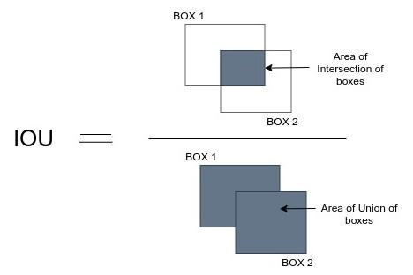
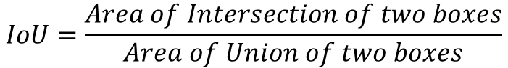
Non-Max Suppression
$$IoU=\frac{Area of Intersection of two boxes}{Area of Union of two boxes}$$
Supervisor: Tran Nhat Quang

Slide 14
Non-Max Suppression
01
Bounding box representation: [x₁, y₁, x₂, y₂, c]
02
Non-Max Suppression Process:
- Get the bounding box with the highest c
- Move it to another list, calculate IoU with a left bounding box
- Which box has IoU > threshold => Remove
- Repeat the first step until there is no box left
Supervisor: Tran Nhat Quang

Slide 15
May 27, 2022
Face Tracking
Supervisor: Tran Nhat Quang

Slide 16
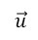
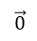
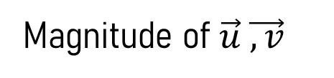
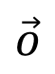
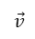
Idea
$$\vec{v}$$
Magnitude
$$\vec{0}$$
$\vec{o}$
Magnitude of $\vec{u} \vec{,v}$
$$\vec{u}$$
Direction
0
x
01
Distance Formula: Distance = Velocity / Time
Assuming that at the first frame: P₁(0, 0), u = 2px/frame, v = 5px/frame
Then, at the second frame: P₂(0 + 2, 0 + 5) = (2, 5) and so on
02
03
Problem: We only have I(x, y, n). How to calculate $\vec{u} \vec{,v}$?
Supervisor: Tran Nhat Quang

Slide 17
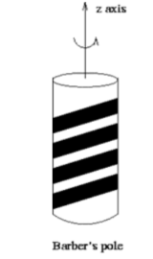

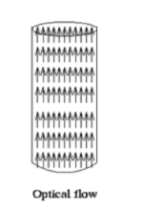
Optical Flow
01
Optical Flow is the apparent motion of brightness patterns in the image.
Supervisor: Tran Nhat Quang
Image Source: Optical Flow, KLT Feature Tracker – HANYANG University

Slide 18
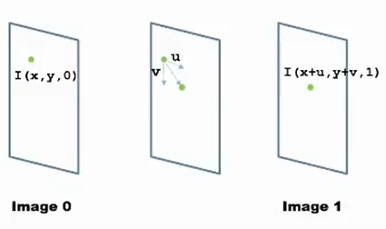
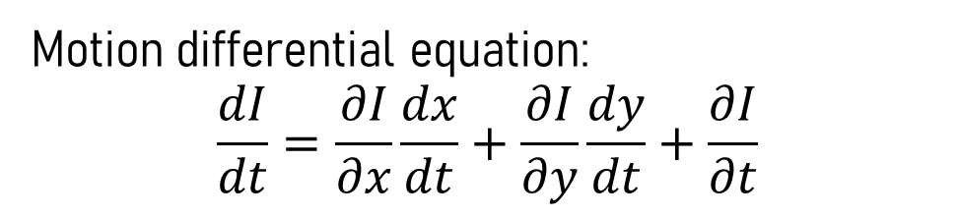
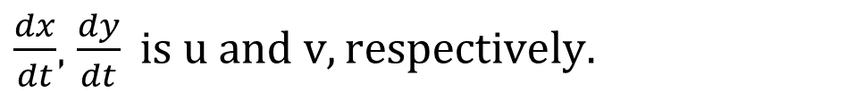
Motion Estimation
Intensity of a pixel in a image
sequence is: I(x, y, n)
01
Motion differential equation:
$$\frac{dI}{dt}=\frac{∂I}{∂x}\frac{dx}{dt}+\frac{∂I}{∂y}\frac{dy}{dt}+\frac{∂I}{∂t}$$
02
$\frac{dx}{dt}$, $\frac{dy}{dt} is u and v, respectively.$
03
Supervisor: Tran Nhat Quang

Slide 19
Motion Assumption
Brightness constancy assumption:
When an object moved slightly, its brightness is unchanged
01
$$I\left(x+u, y+v, t+1\right)=I(x, y, t)$$
02
When u and v are small (<1pixel), using Taylor expansion we have:
$$I\left(x+u, y+v, t+1\right)=I\left(x, y, t\right)+I_{x}u+ I_{y}v+I_{t}$$
03
Spatial Smoothness:
Neighboring pixel in the image are likely to belong to the same surface
Surfaces are mostly smooth
Neighboring pixels will have similar flow
Supervisor: Tran Nhat Quang

Slide 20
Motion Assumption
01
Combine equation at assumption (1) and (2)
$$I\left(x+u, y+v, t+1\right)=I(x, y, t)$$
$$I\left(x+u, y+v, t+1\right)=I\left(x, y, t\right)+I_{x}u+ I_{y}v+I_{t}$$
We have:
$$I_{x}u+ I_{y}v+I_{t}=0$$
Assume we have I = [1 2 4 6 5] is the intensity values along x-axis Then we can calculate I_{x} = [1 2 2 -1] is the rate of change of intensity
02
Supervisor: Tran Nhat Quang

Slide 21
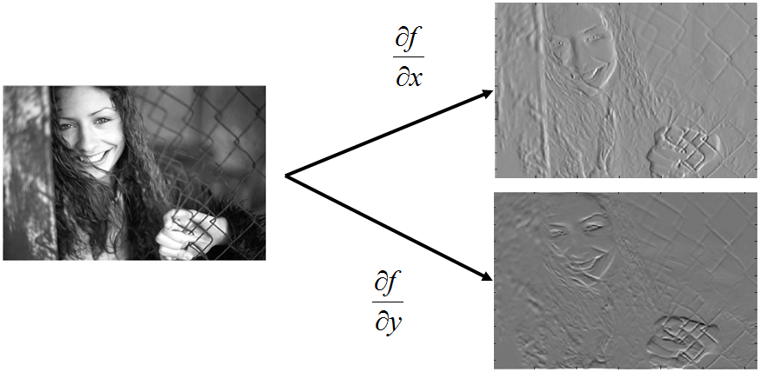
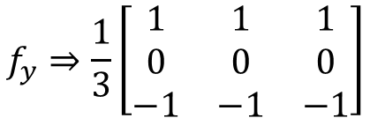
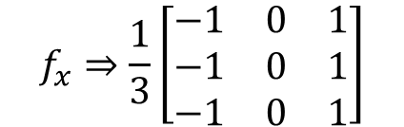
Image Derivative
$$f_{x}⇒\frac{1}{3}\left[\begin{matrix}−1 & 0 & 1 \\ −1 & 0 & 1 \\ −1 & 0 & 1\end{matrix}\right]$$
$$f_{y}⇒\frac{1}{3}\left[\begin{matrix}1 & 1 & 1 \\ 0 & 0 & 0 \\ −1 & −1 & −1\end{matrix}\right]$$
Supervisor: Tran Nhat Quang

Slide 22
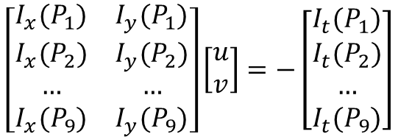
Motion Assumption
$$I_{x}u+ I_{y}v+I_{t}=0$$
01
Spatial Smoothness:
Neighboring pixel in the image are likely to belong to the same surface
Surfaces are mostly smooth
Neighboring pixels will have similar flow
$$\left[\begin{matrix}I_{x}(P_{1}) & I_{y}(P_{1}) \\ I_{x}(P_{2}) & I_{y}(P_{2}) \\ … & … \\ I_{x}(P_{9}) & I_{y}(P_{9})\end{matrix}\right]\left[\begin{matrix}u \\ v\end{matrix}\right]=−\left[\begin{matrix}I_{t}(P_{1}) \\ I_{t}(P_{2}) \\ … \\ I_{t}(P_{9})\end{matrix}\right]$$
Supervisor: Tran Nhat Quang

Slide 23
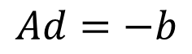
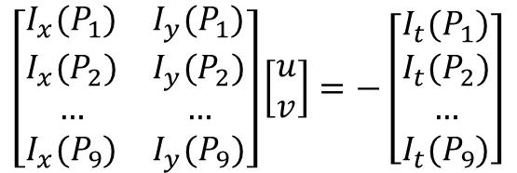

Lucas-Kanade
$$\left[\begin{matrix}I_{x}(P_{1}) & I_{y}(P_{1}) \\ I_{x}(P_{2}) & I_{y}(P_{2}) \\ … & … \\ I_{x}(P_{9}) & I_{y}(P_{9})\end{matrix}\right]\left[\begin{matrix}u \\ v\end{matrix}\right]=−\left[\begin{matrix}I_{t}(P_{1}) \\ I_{t}(P_{2}) \\ … \\ I_{t}(P_{9})\end{matrix}\right]$$
$$Ad=−b$$
01
Lucas-Kanade: The best u, v are the ones that minimize ${\left\|Ad−b\right\|}^{2}$
$${(A}^{T}A)d=A^{t}b$$
$$\left[\begin{matrix}\sum{I_{x}}I_{x} & \sum{I_{x}}I_{y} \\ \sum{I_{x}}I_{y} & \sum{I_{y}}I_{y}\end{matrix}\right]\left[\begin{matrix}u \\ v\end{matrix}\right]=−\left[\begin{matrix}\sum{I_{x}}I_{t} \\ \sum{I_{y}}I_{t}\end{matrix}\right]$$
Supervisor: Tran Nhat Quang

Slide 24
Lucas-Kanade
01
Problem: If we apply this to all pixels => Large computational weight
Load Image
Detect ROI
Key Points
Calculate (u, v)
Supervisor: Tran Nhat Quang

Slide 25
Key points
01
Key points are groups of pixels that are repeatable and distinctive
02
Key points should be invariant to image transformation
Supervisor: Tran Nhat Quang

Slide 26
Key points
Using Harris Algorithm
RGB
Gray
Edge
Supervisor: Tran Nhat Quang

Slide 27
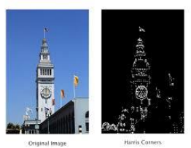

Corners as Key points
$$E\left(u, v\right)= \sum{w\left(x, y\right){[I\left(x+u, y+v\right)−I\left(x, y\right)]}^{2}}$$
RGB
Gray
Edge
Error Image
Supervisor: Tran Nhat Quang

Slide 28

Corners as Key points
$$E\left(u, v\right)= \sum{w\left(x, y\right){[I\left(x+u, y+v\right)−I\left(x, y\right)]}^{2}}$$
$$E\left(u, v\right) ≈\left[\begin{matrix}u & v\end{matrix}\right] M\left[\begin{matrix}u \\ v\end{matrix}\right]$$
$$M=\sum_{x, y}{w(x, y)}\left[\begin{matrix}I_{x}^{2} & I_{x}I_{y} \\ I_{x}I_{y} & I_{y}^{2}\end{matrix}\right]$$
Supervisor: Tran Nhat Quang

Slide 29
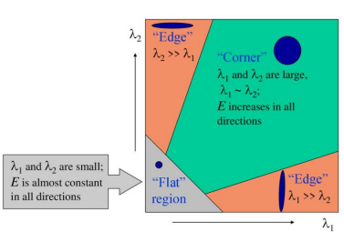
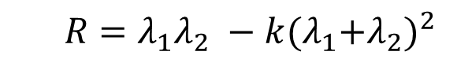
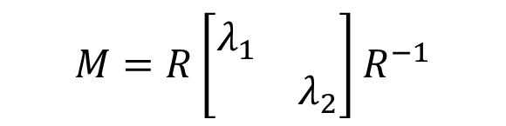
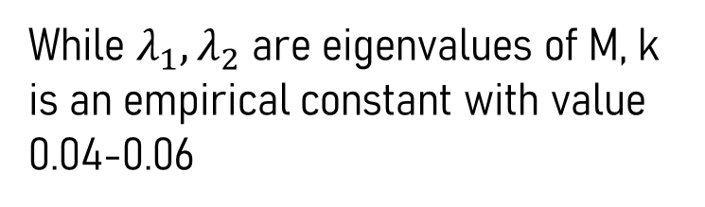
Corners as Key points
01
Tomashi Algorithm
$$M=R\left[\begin{matrix}λ_{1} & \\ & λ_{2}\end{matrix}\right]R^{−1}$$
$$R=λ_{1}λ_{2} −k{(λ_{1}{+λ}_{2})}^{2}$$
While $λ_{1}{, λ}_{2}$ are eigenvalues of M, k is an empirical constant with value
0.04-0.06
Supervisor: Tran Nhat Quang

Slide 30
Corners as Key points
corners = cv2.goodFeaturestoTrack(gray, maxCorners, qualityLevel, minDistance)
01
gray: Gray Image
02
maxCorners: Maximum corner number to track
03
qualityLevel: Threshold to filter key points
04
minDistance : Minimum distance to be recognized as key points
Supervisor: Tran Nhat Quang

Slide 31
Kanade-Lucas-Tomashi Tracker
cv.calcOpticalFlowPyrLK(prevImage, nextImage, prevPts, nextPts, maxLevel)
01
prevImage : Image that we have key points coordinate
02
nextImage : Image that we want to predict key points coordinate
03
prevPts : Key points coordinate that we’ve already have
04
nextPts : Key points coordinate that will be predicted
Supervisor: Tran Nhat Quang

Slide 32
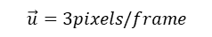
Kanade-Lucas-Tomashi Tracker
02
When u and v are small (<1pixel), using Taylor expansion we have:
$$I\left(x+u, y+v, t+1\right)=I\left(x, y, t\right)+I_{x}u+ I_{y}v+I_{t}$$
$$\vec{u}=3pixels/frame$$
0
x
Supervisor: Tran Nhat Quang

Slide 33
May 27, 2022
Thanks for Watching
Let’s go to code
Supervisor: Tran Nhat Quang

